Slide 1
Machine Learning for the study of glacial-interglacial cycles (TFM)
Experiment A1: SINDy for recovering PACCO equations
Adrián Ordóñez Sanmartín
29/04/2026

Slide 2


What is the plan and what have we already done?
In the previous weeks we did this.
We found 100 ky cycles. Poor stability and not that sparse results.
Validation
Experiment A - SINDy to PACCO with all the variables
A1 - Not noisy, equally spaced.
A2 - Noisy, equally spaced.
A3 - Not noisy, unequally spaced.
A4 - Not noisy, unequally spaced.
Experiment B - SINDy to PACCO only with proxy observables (“H”, C, I).
B1 - Not noisy, equally spaced.
B2 - Not noisy, unequally spaced.
Experiment C - SINDy to proxy data.
We will define this in the future.
Now we try this, to really validate the method.
Real
results
2

Slide 3

A1 - Methodology
We try to recover PACCO equations (for the 5 pronostical variables). In the first approximation, this are its dependencies:
dT/dt = F(H, B, H_sed, C, T, I)
dC/dt = F(C, T)
dH/dy = F(T, α, H^3, I)
dB/dt = F(H, B)
d(H_sed)/dt = F(T, H^4)
We have not included the albedo variable, since its anomalous behaviour confused SINDy
We also find for hysteresis, using the continuation method.
3

Slide 4
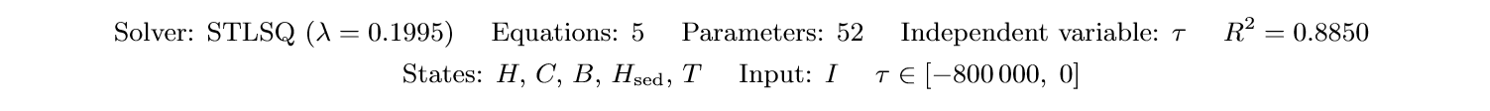
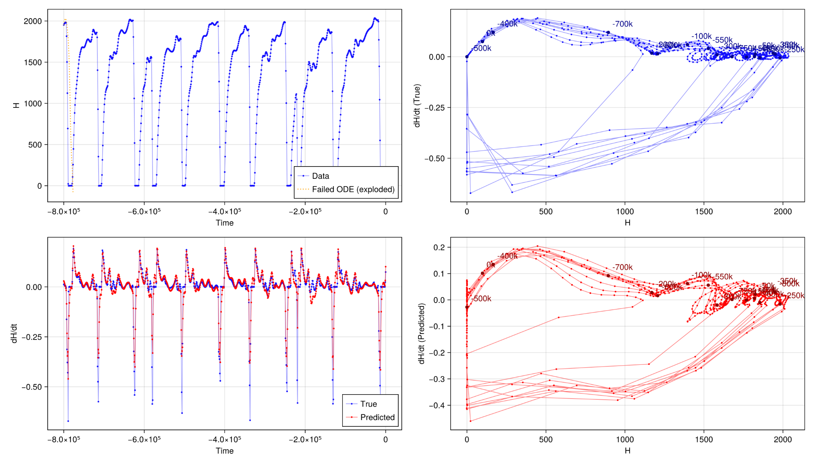
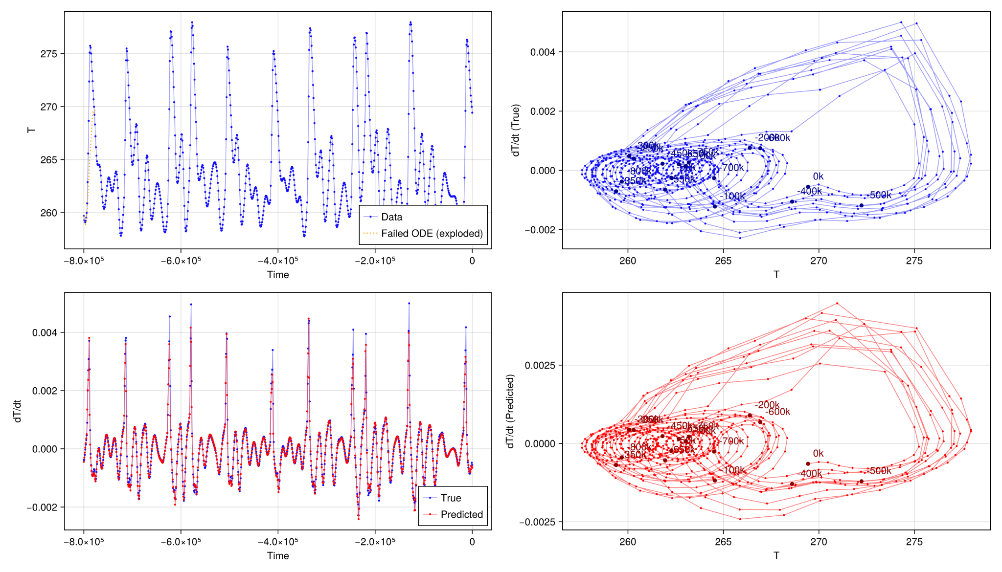
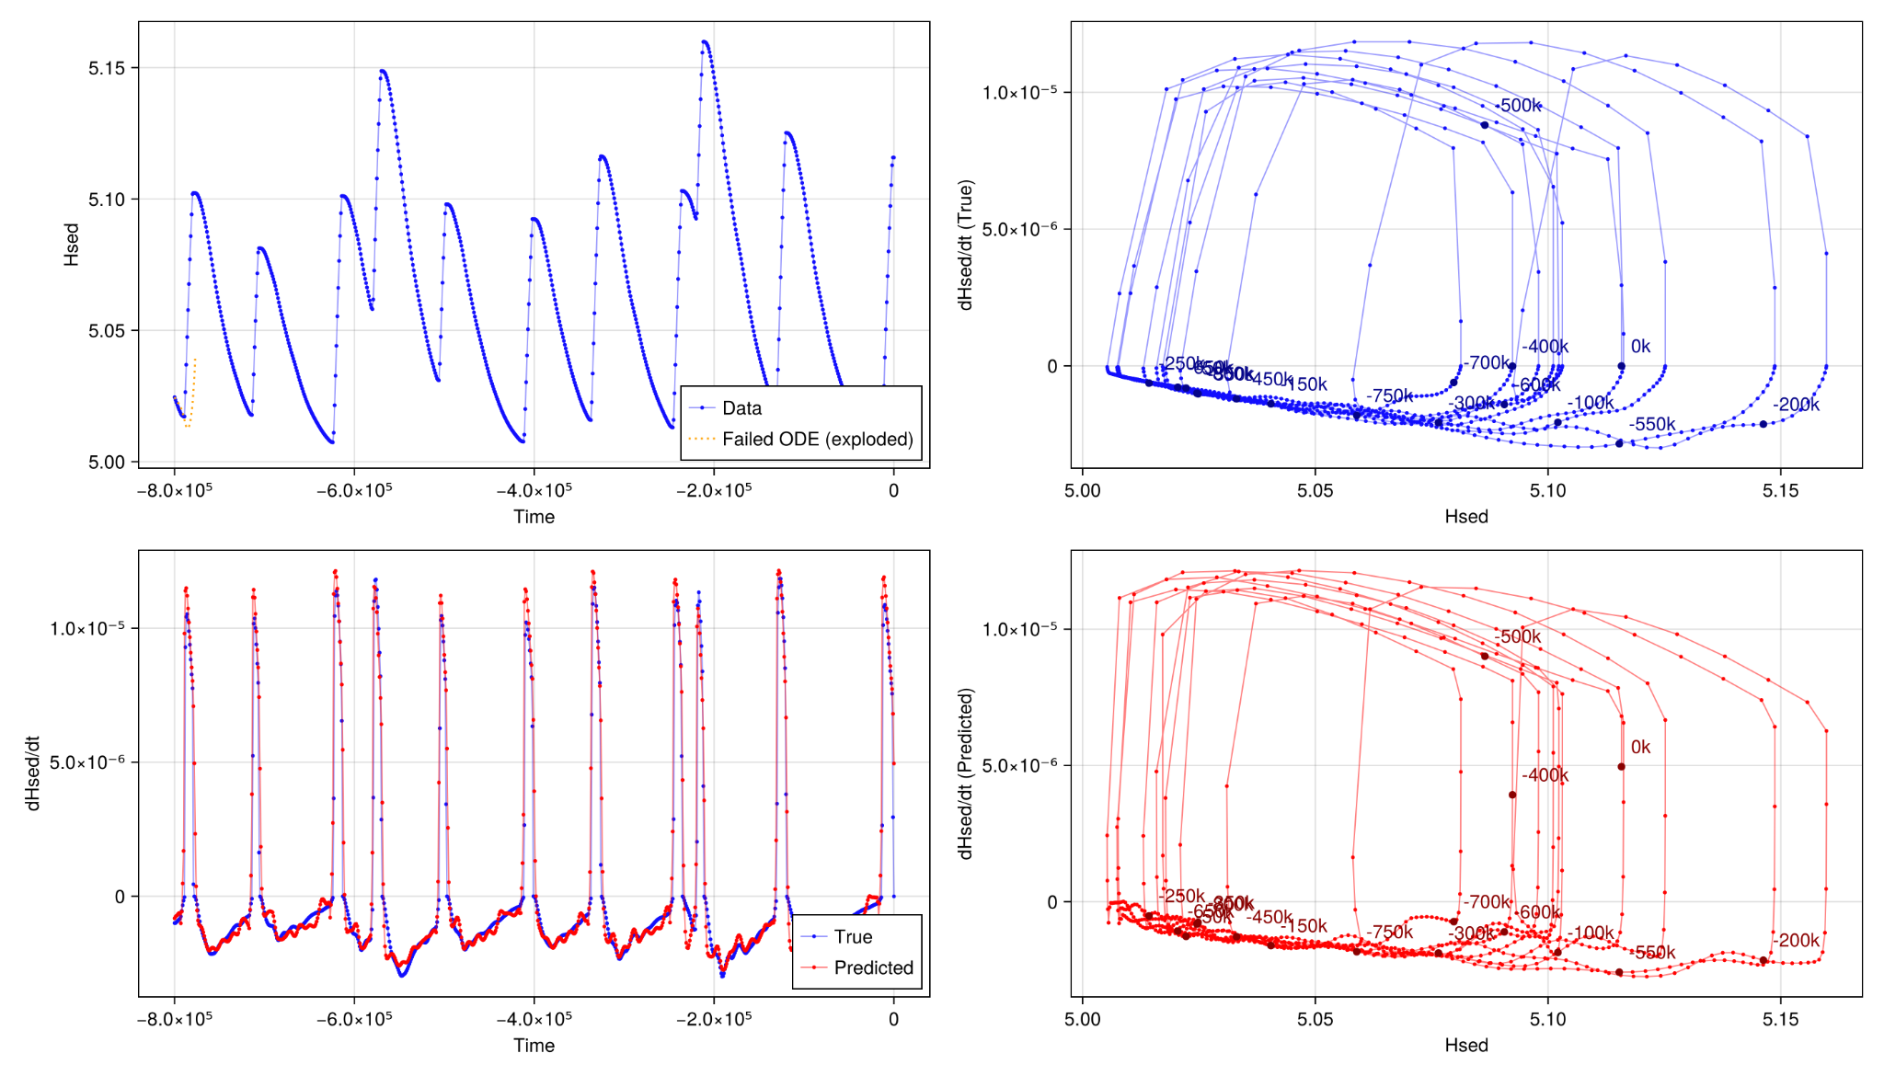
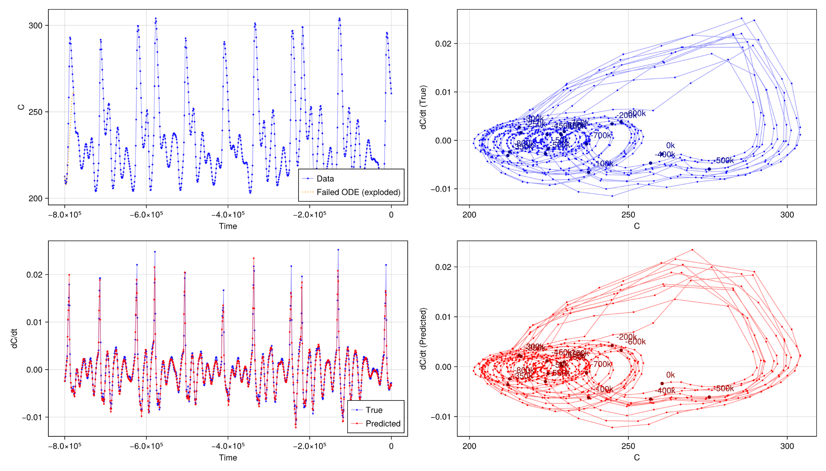
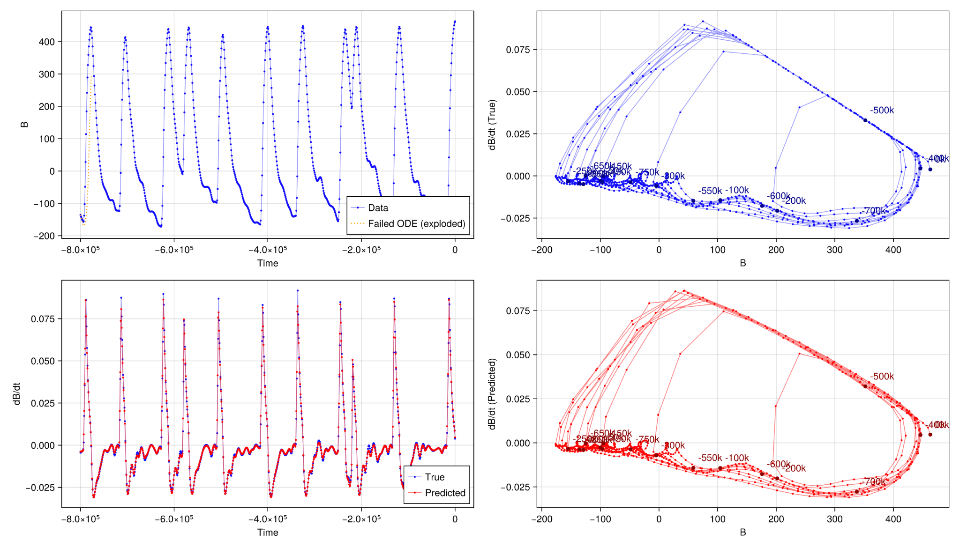
Result 1 - Best fit. Hysteresis. Not sparse.
H
T
H_sed
C
B
Phase diagrams for the 5 prognostic variables. In blue, with the numerical derivative. In red, with the discovered derivative
Trajectories are well represented for all variables. No one was stable under integration.
4

Slide 5
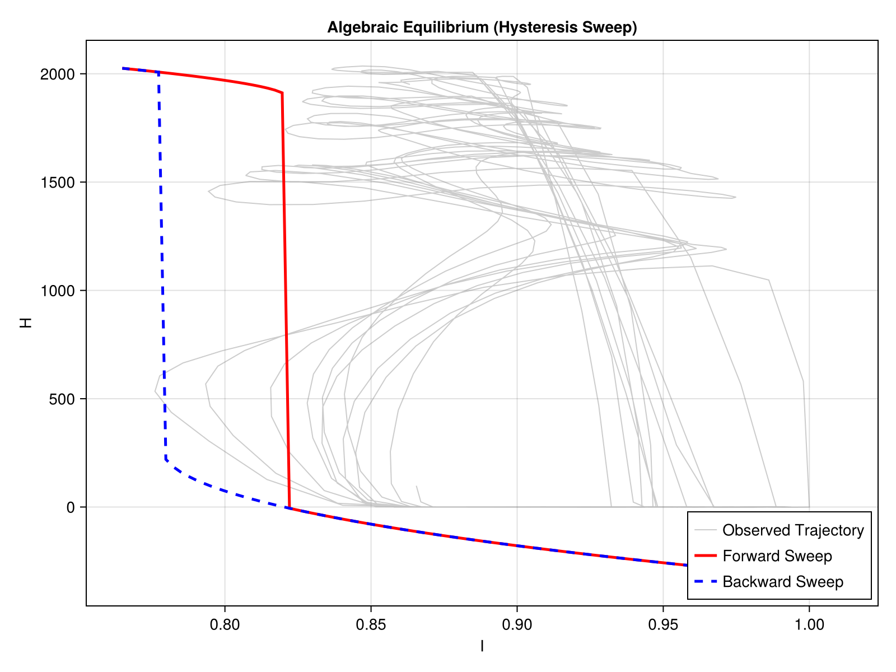
Result 1 - Best fit. Hysteresis. Not sparse.
H*T term made the hysteresis appear
Hysteresis is found for all 5 variables vs I.
For reference:
I = 1 is 565 W/m^2
5

Slide 6
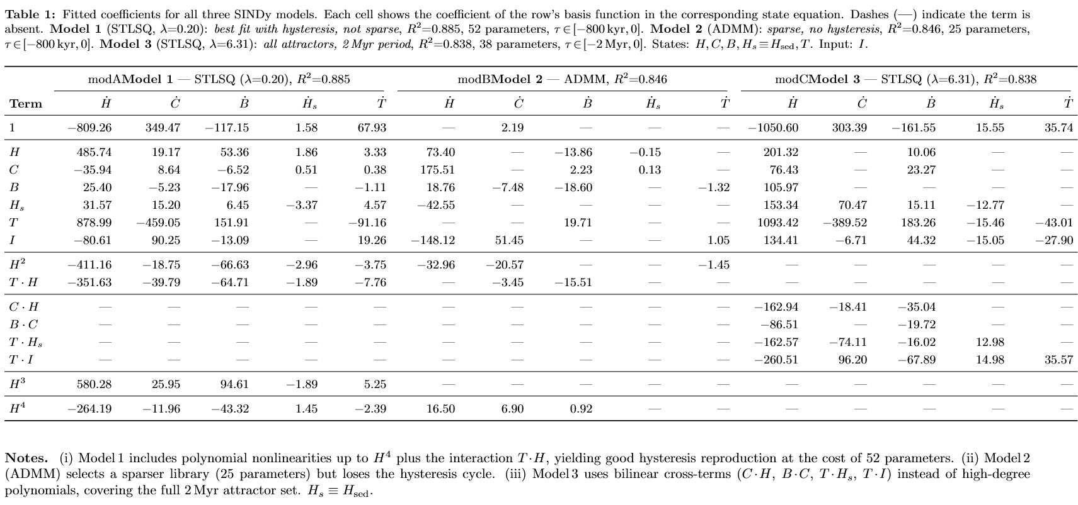
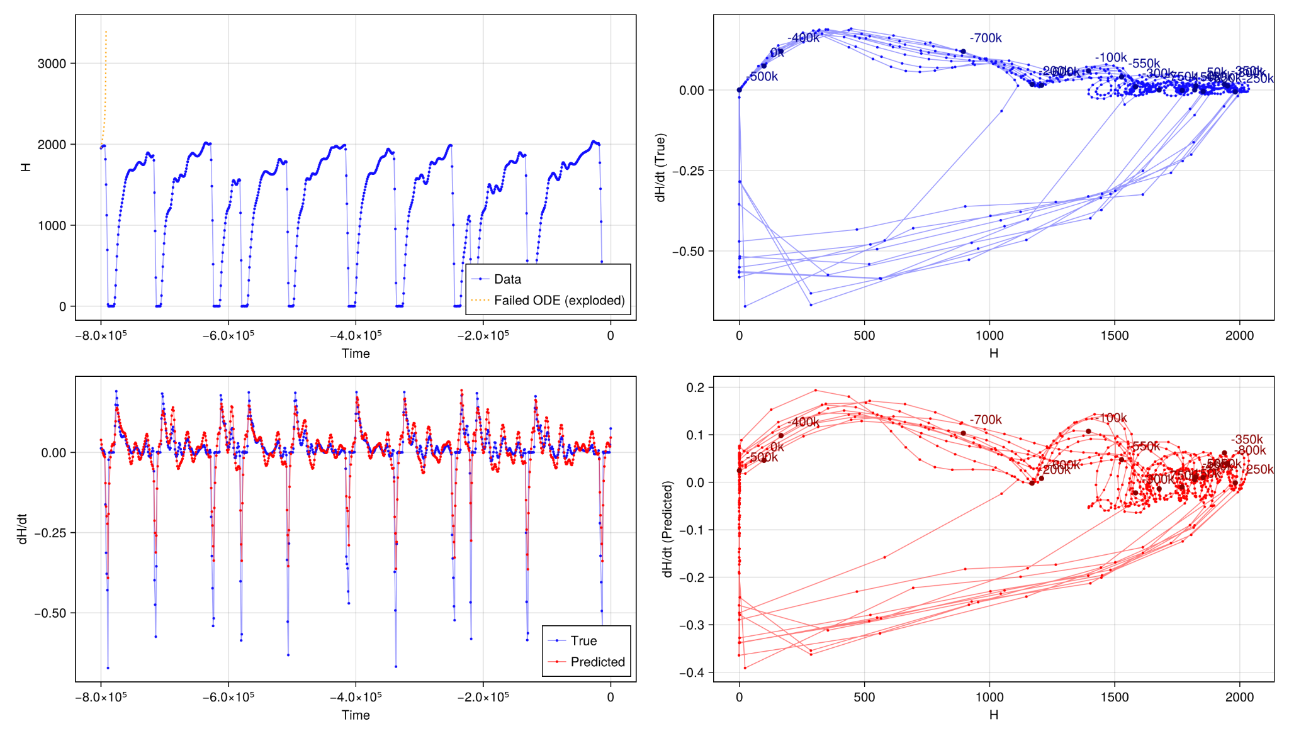
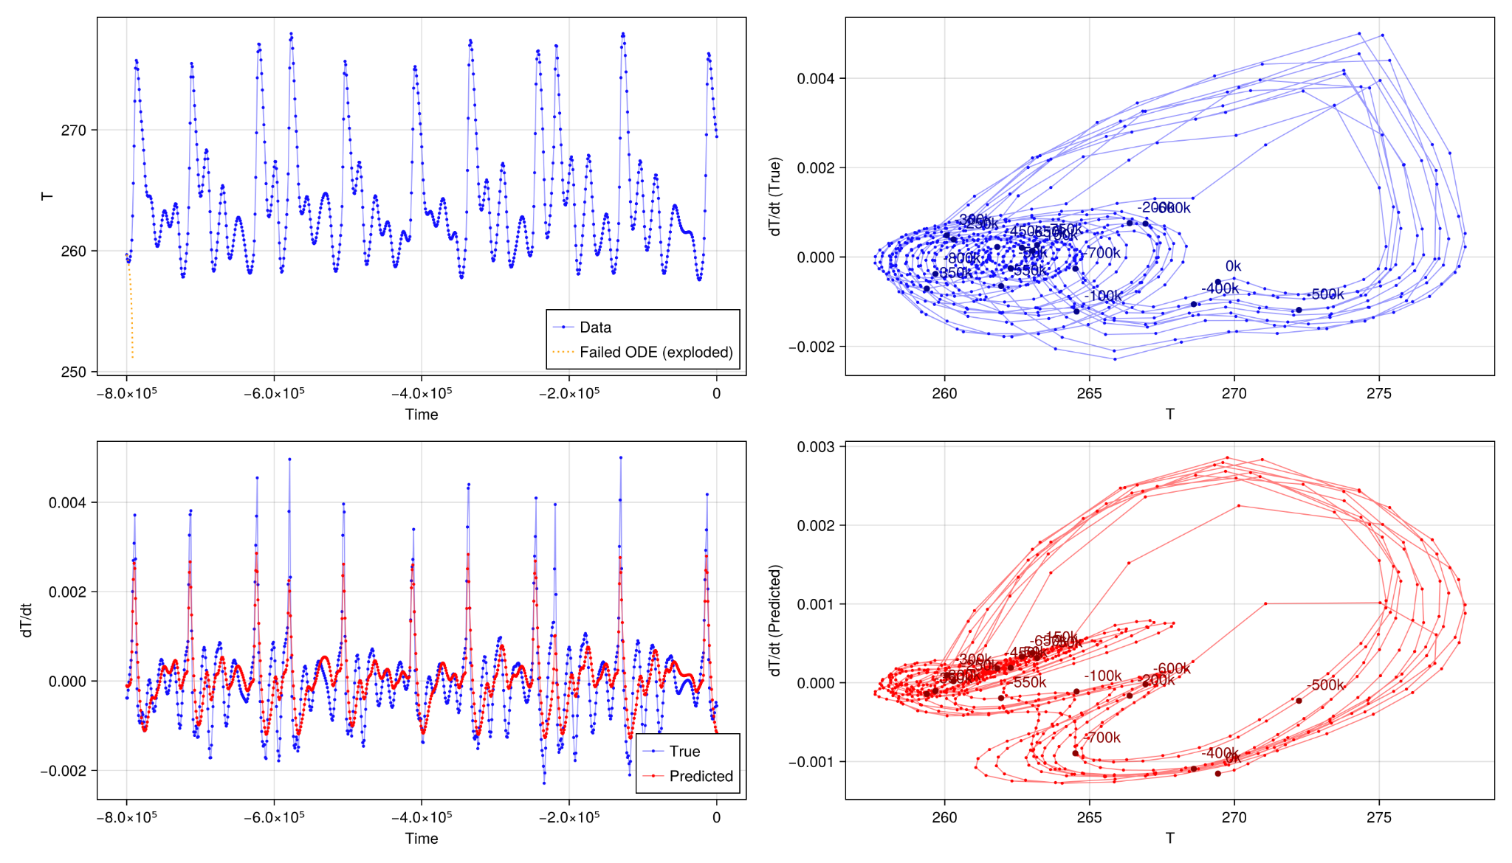
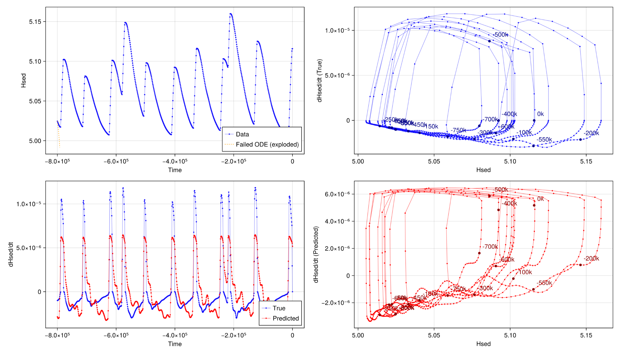
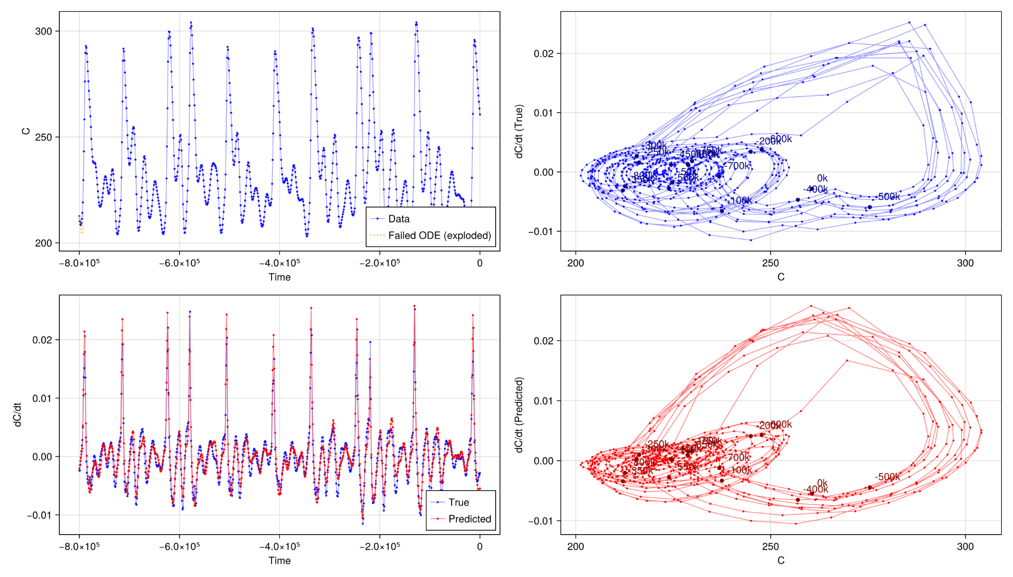
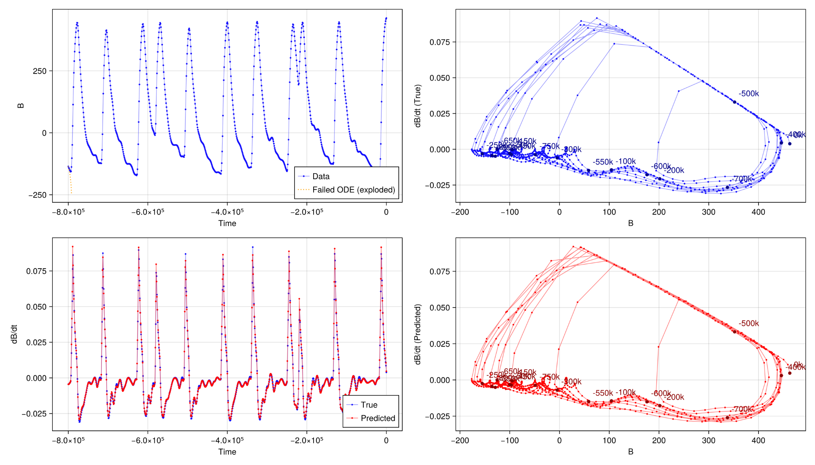
Result 2 - Sparser, but not hysteretic.
H
T
H_sed
C
B
T
We have lost some precision. Even the attractor in T. Not even one of the variables was stable over integration
Phase diagrams for the 5 prognostic variables. In blue, with the numerical derivative. In red, with the discovered derivative
6

Slide 7
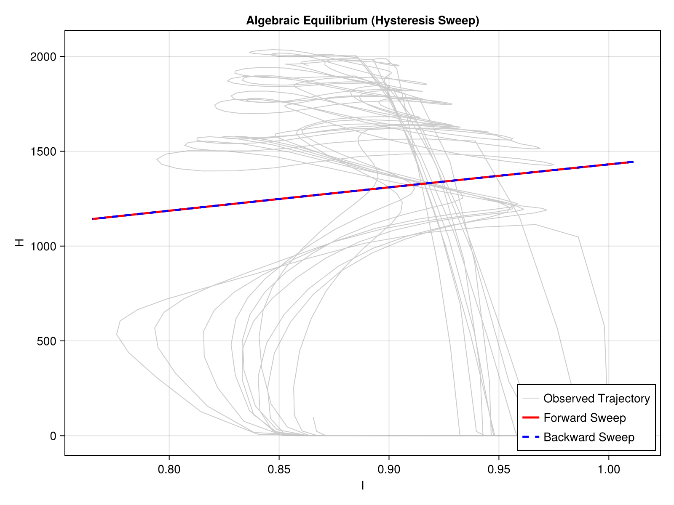
Result 2 - Sparser, but not hysteretic.
Hysteresis is lost for all 5 variables vs I.
For reference:
I = 1 is 565 W/m^2
7

Slide 8
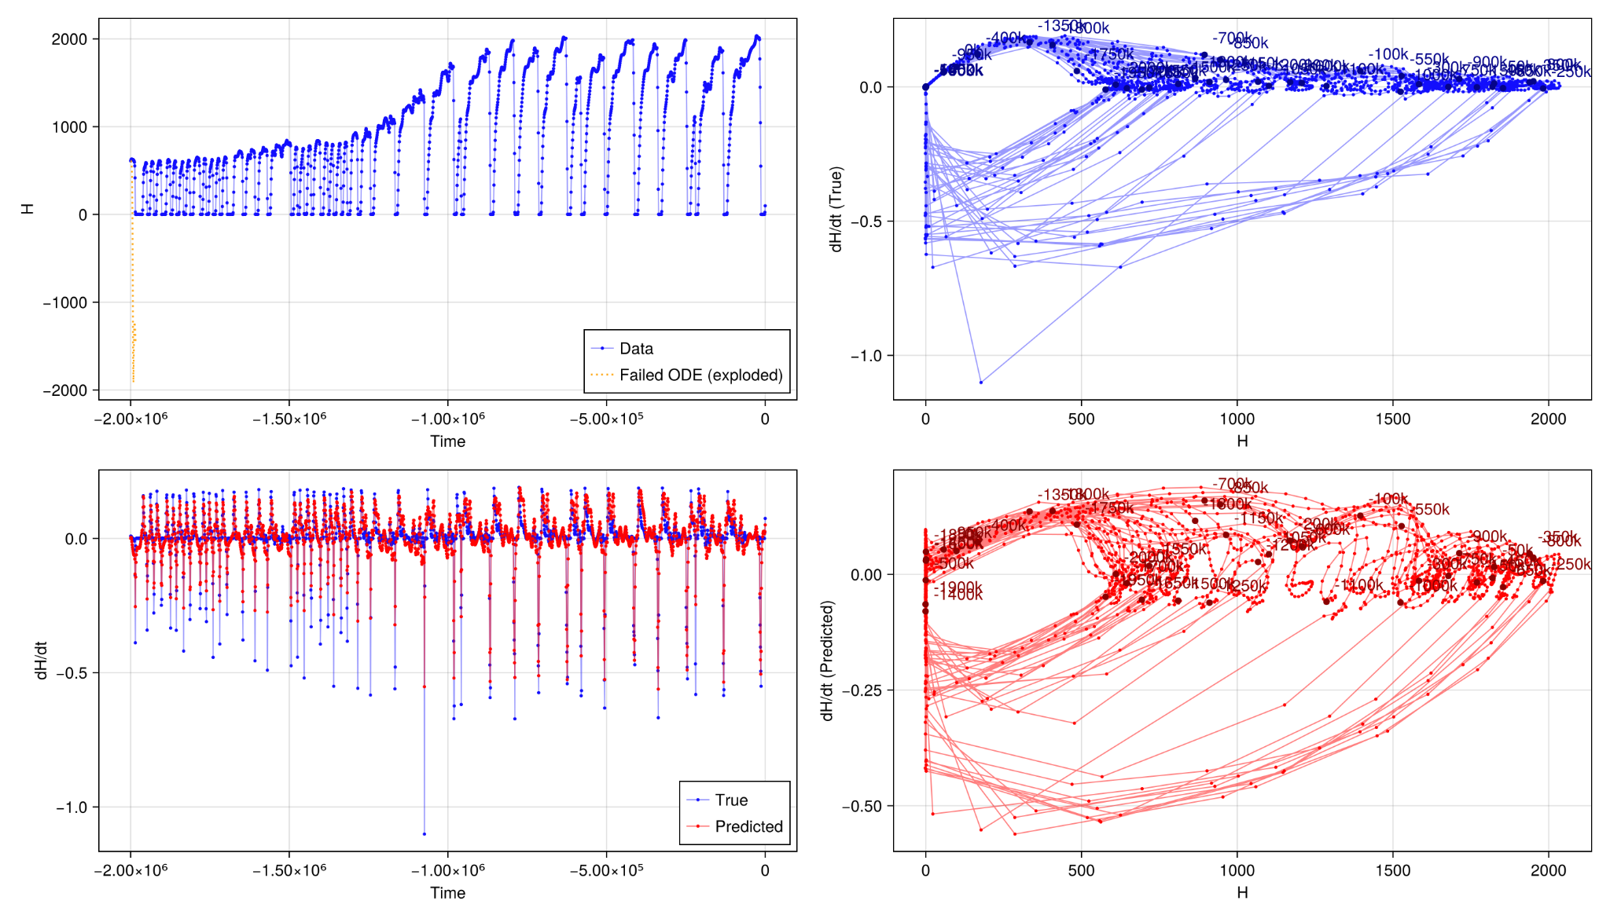
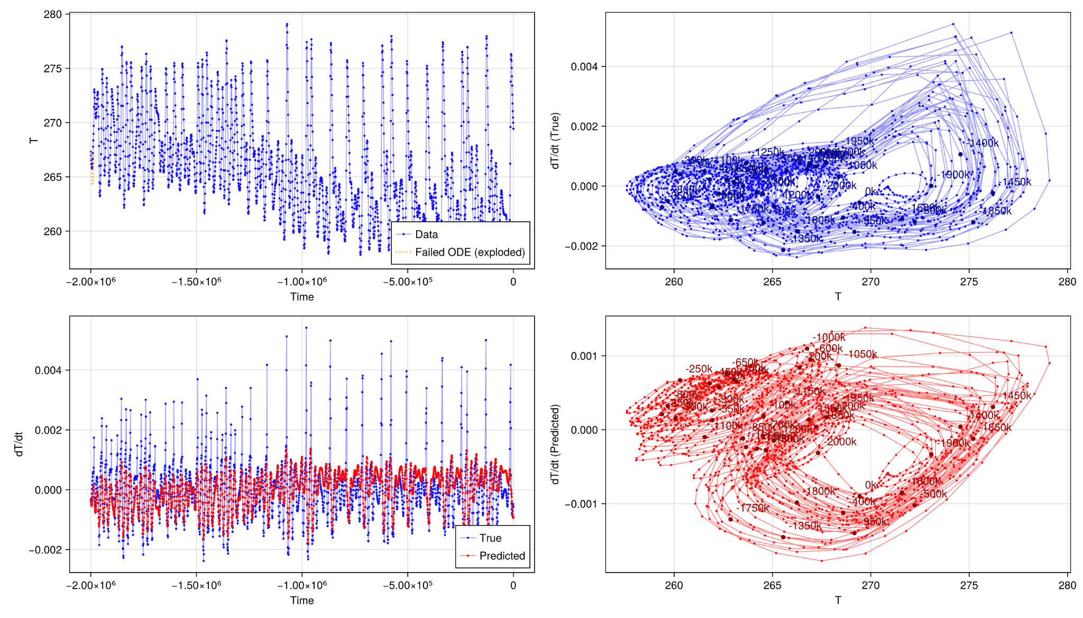
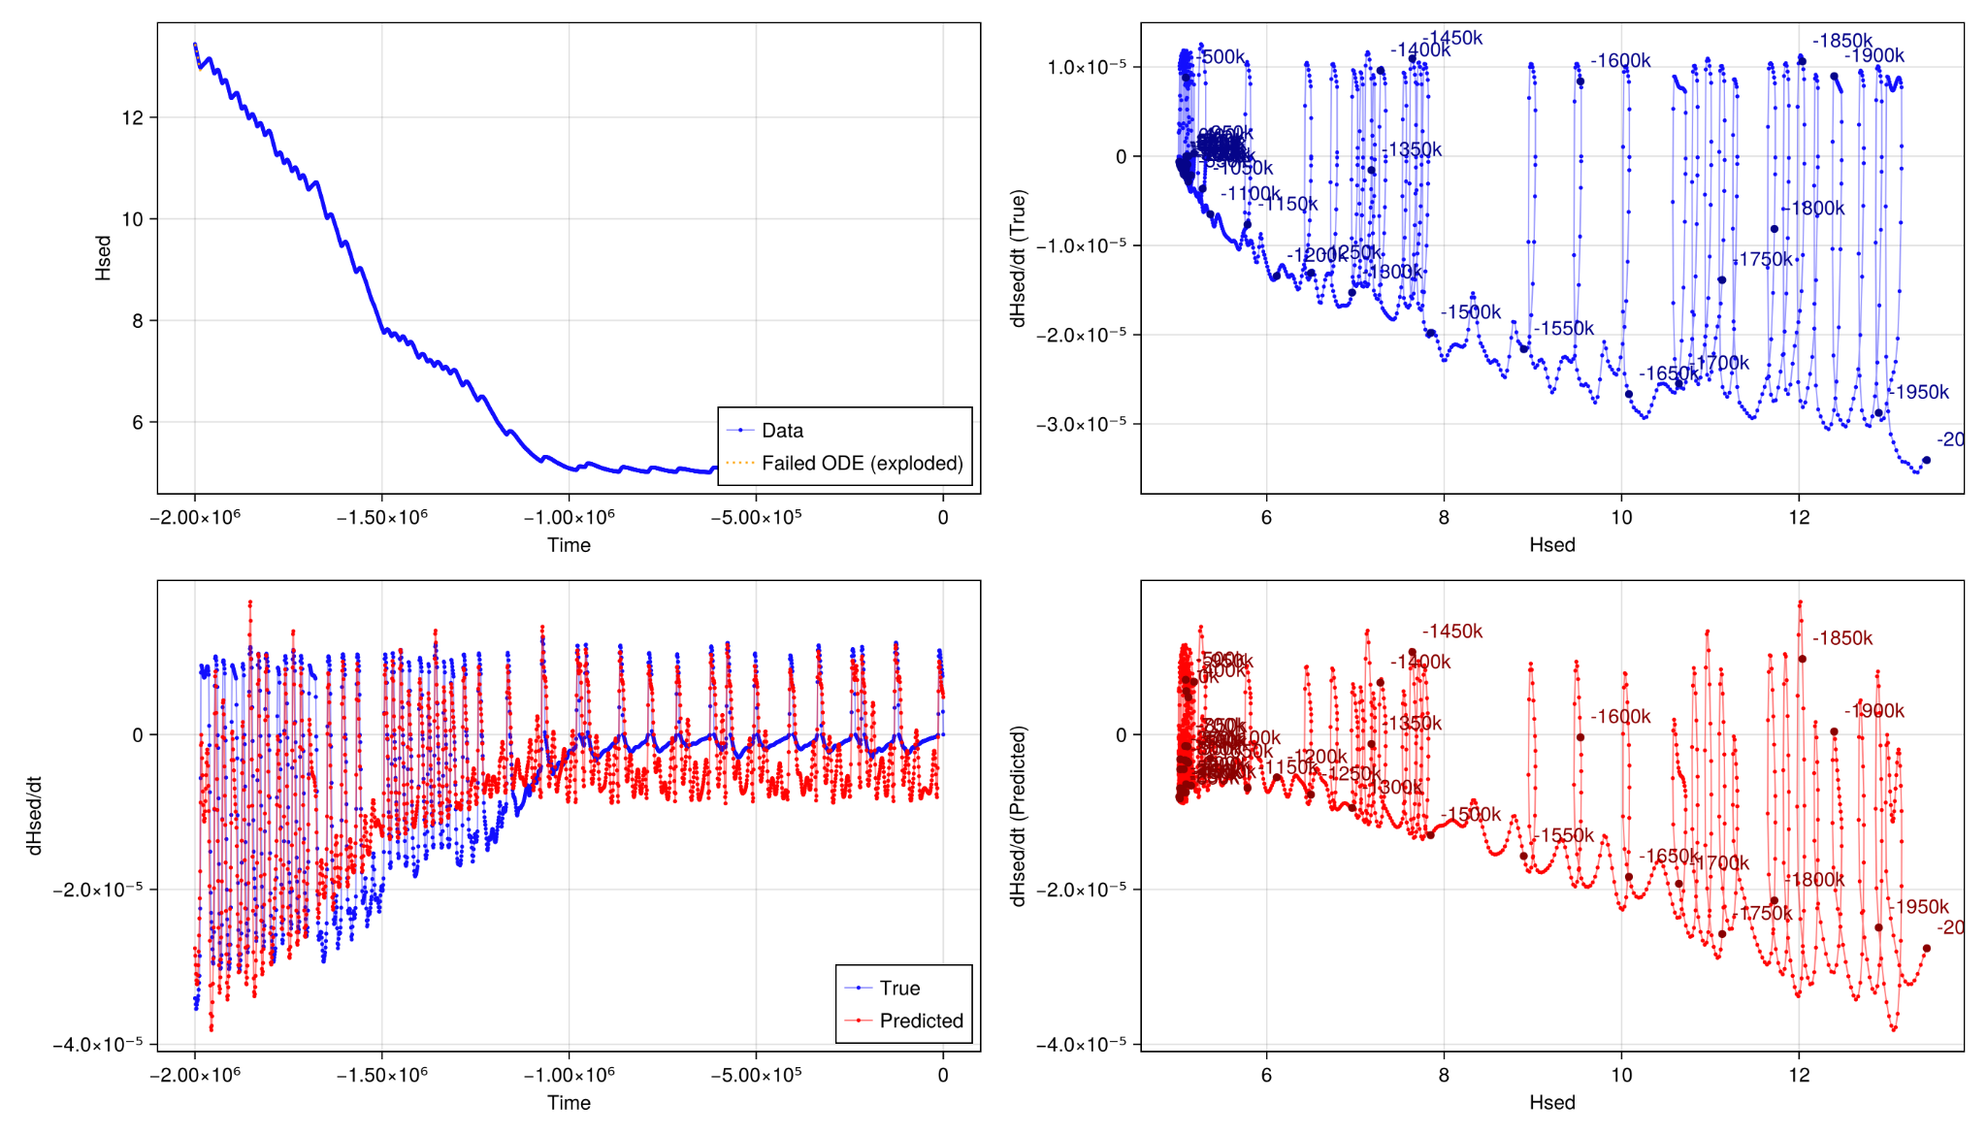
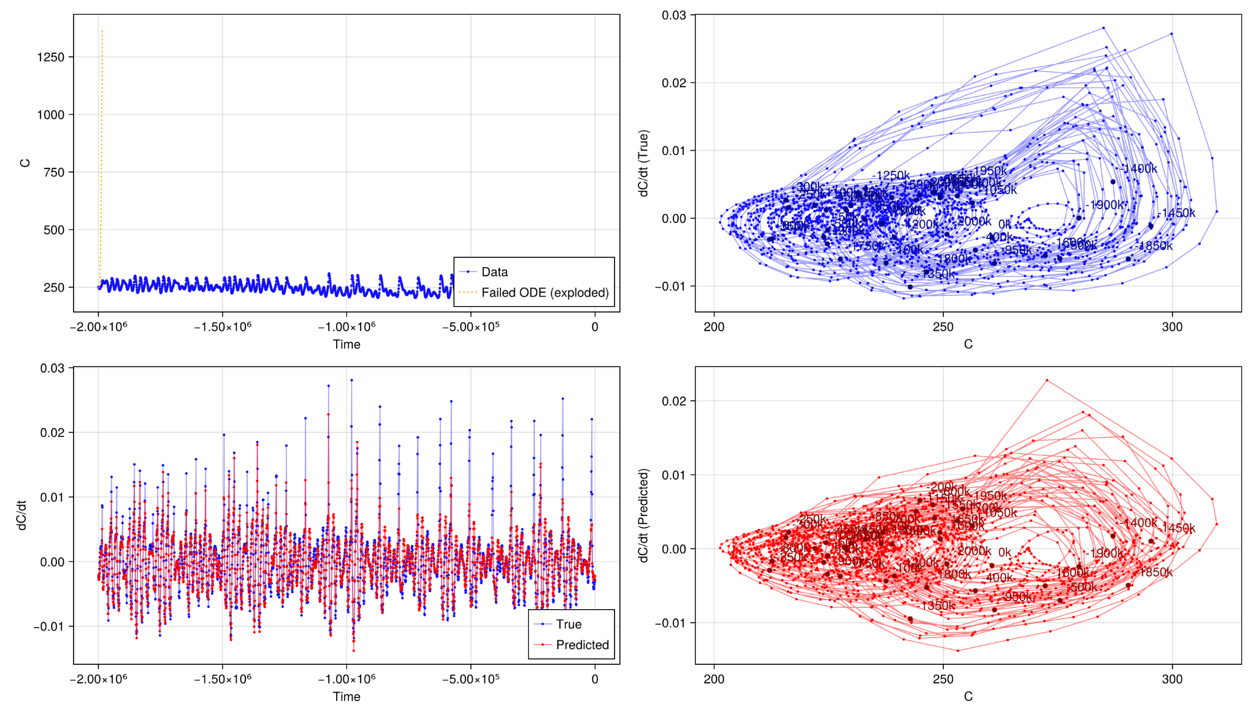
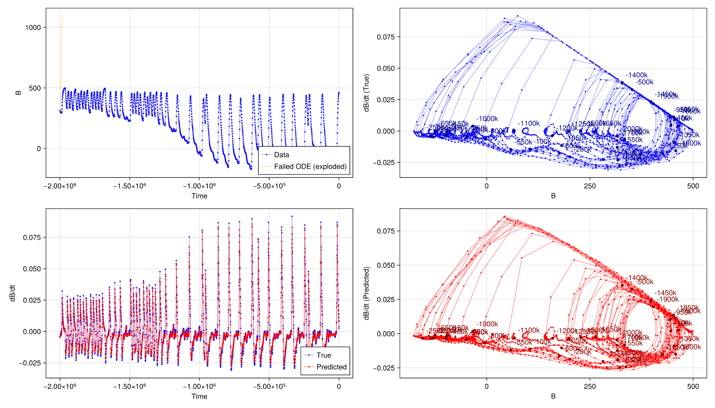
Result 3 - Last 2 Myr.
Phase diagrams for the 5 prognostic variables. In blue, with the PACCO data. In red, with the discovered model.
8
H
T
H_sed
C
B

Slide 9
Result 1-3 SINDy discovered equations
9

Slide 10
Conclusions
Hysteresis found
We have a tool for searching which variables produce the hysteresis
PACCO “kinda of” rediscovered?
It is difficult to say. Of course, we have at least discovered a really good approximation
10

